Slide 1
Dissertation Proposal Meeting
Sean Duan

Slide 2
Dissertation Proposal Meeting Outline
Introduction
Study 1
Study 2
Proposed Study 3

Slide 3
Introduction
Problem Statement: Changing polarized beliefs has becoming increasingly important because:
Polarization is increasing (political belief, belief in science, etc.)
Polarizing beliefs resulting in negative consequences (vaccine hesitancy, lack of reproductive healthcare, etc.) are difficult to change.

Slide 4
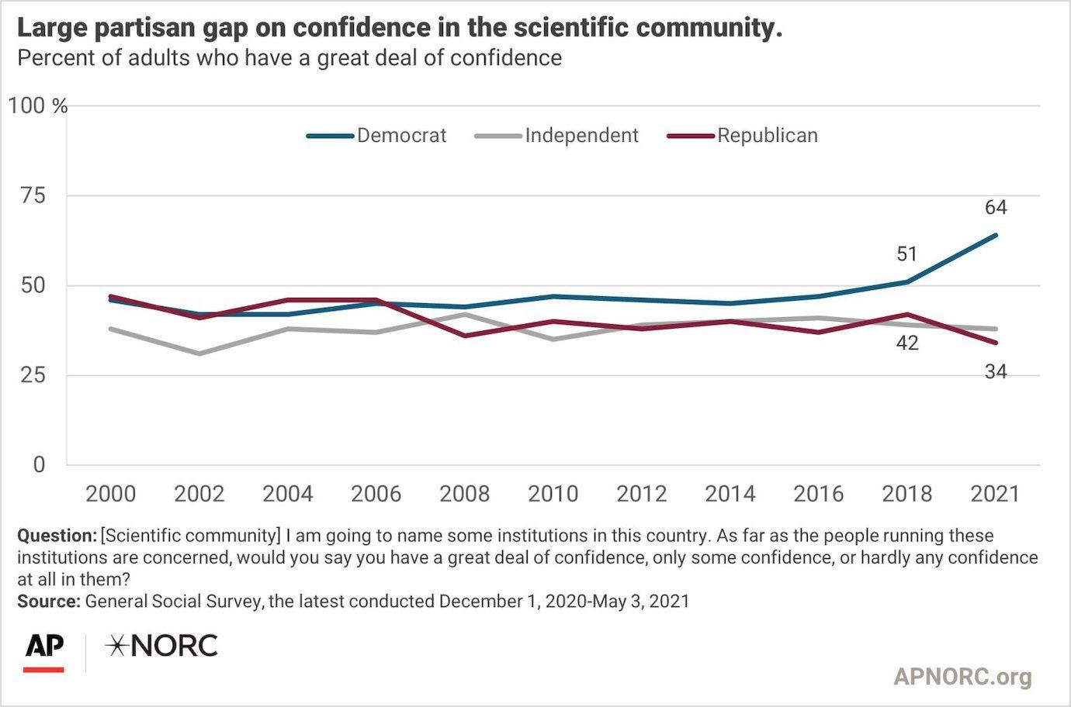

Slide 5
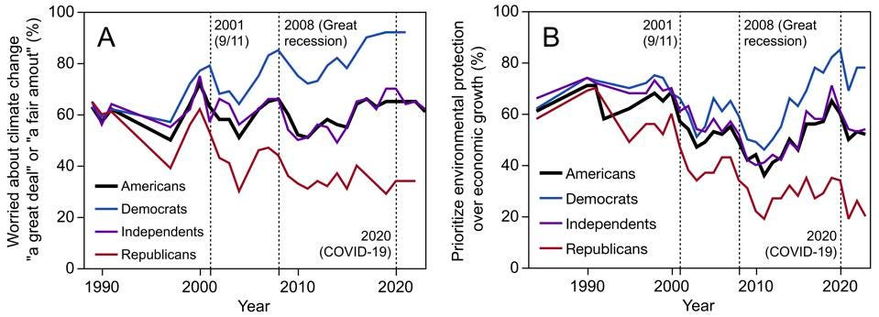

Slide 6

Introduction
Research Question: What are some under-explored processes that affect openness to change for polarized beliefs:
Two main constructs examined
Moral Conviction
Social Consensus

Slide 7
Study 1
Social Memory and Recollection on Current and Past Issues

Slide 8
Research Questions
Does this manipulation work well in changing social consensus?
How much does social consensus manipulation affect support for a variety of polarized beliefs?
Do individual differences in deontology/utilitarianism affect belief change?

Slide 9
Participants
Psychology 1000 Students (N = 505)
Age M (SD): 18.9 (1.99)
Preferred gender identity
Female – 63.6%
Male – 33.5%
Gender Variant or Nonconforming – 1.4%
Prefer not to say – 1.6%
Self-Identified race
White – 77%
Black – 5.3%
Hispanic – 6.7%
Asian – 5.1%
Native American – 0.39%
Other – 2.4%
Prefer not to say – 1.6%

Slide 10
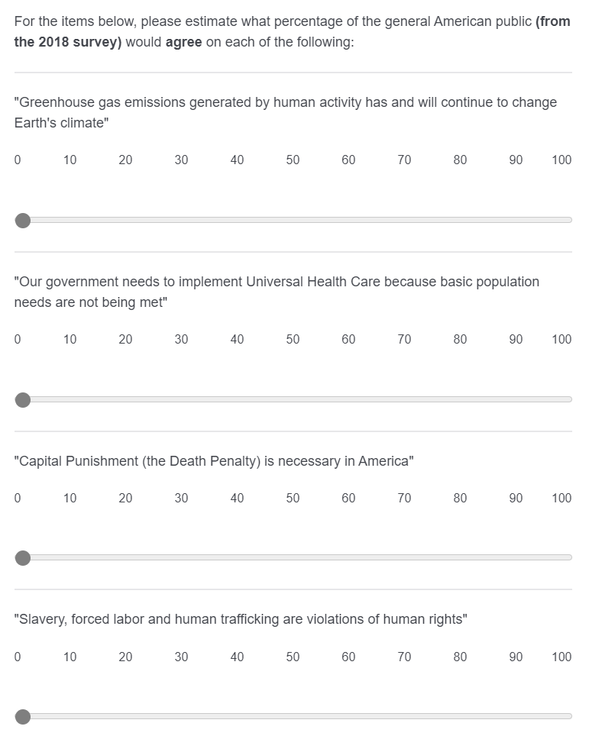
Method

Slide 11
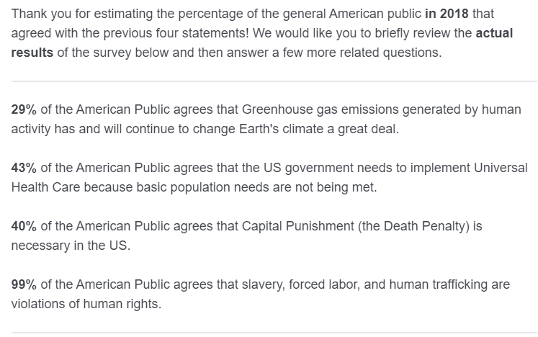
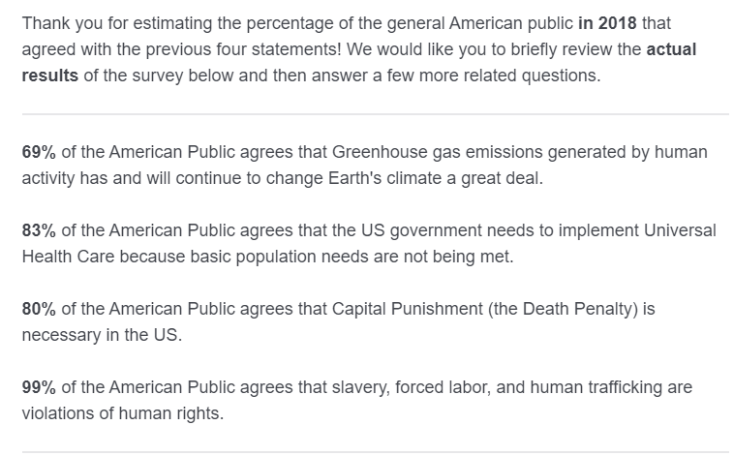
Method
Low social consensus condition
High social consensus condition

Slide 12
Outcomes

Slide 13
Study Design
Repeated measures design
2 Independent Variables:
Time: Before or After consensus manipulation
Social Consensus: Low (-20%) or High (+20%)
2 x 2 design
Participants rated their support for an issue before the manipulation, and after the manipulation – social consensus was between subjects, randomly assigned to low or high.
Measured individual differences: deontological and utilitarian orientation, health literacy, subjective and objective numeracy

Slide 14
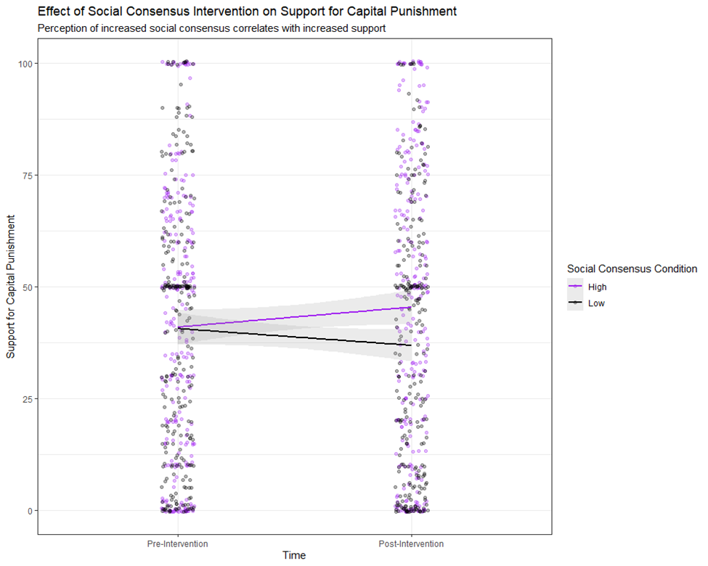
Results

Slide 15
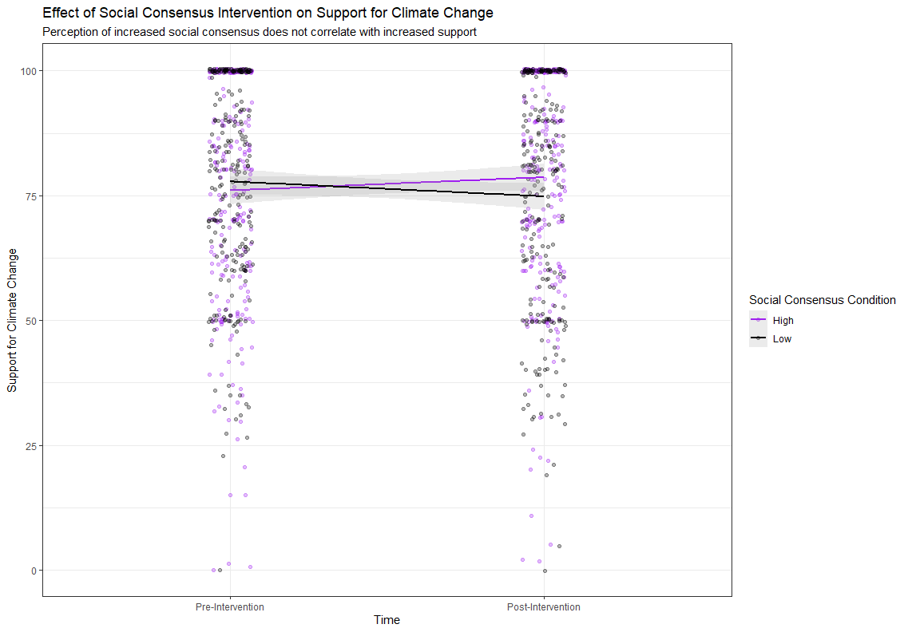
Results

Slide 16
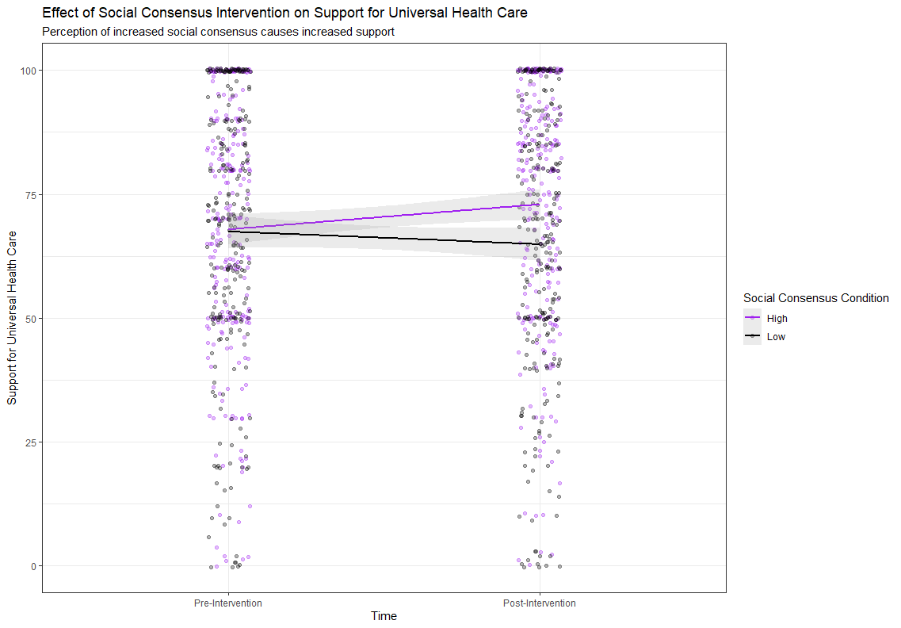
Results

Slide 17
Conclusions
Strong support for social consensus manipulation working
Potential ‘ceiling effect’ issues for ‘Climate Change’ topic
Deontological orientation affected support for UHC
No individual differences effects from:
Subjective numeracy
Objective numeracy
Health literacy
Utilitarian orientation

Slide 18
Study 2
Effect of Moral Conviction on Current and Past Issues

Slide 19
Research Questions
Does this manipulation work well in changing moral conviction?
How much do changing levels of moral conviction affect support for [topic]?
How do individual differences in openness to belief change affect levels of moral conviction by condition, and support for [topic]?

Slide 20
Participants
Psychology 1000 Students (N = 208)
Demographic information was not collected

Slide 21
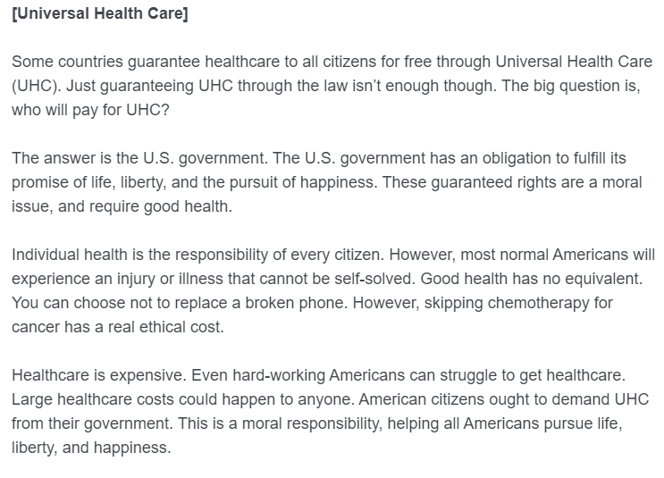
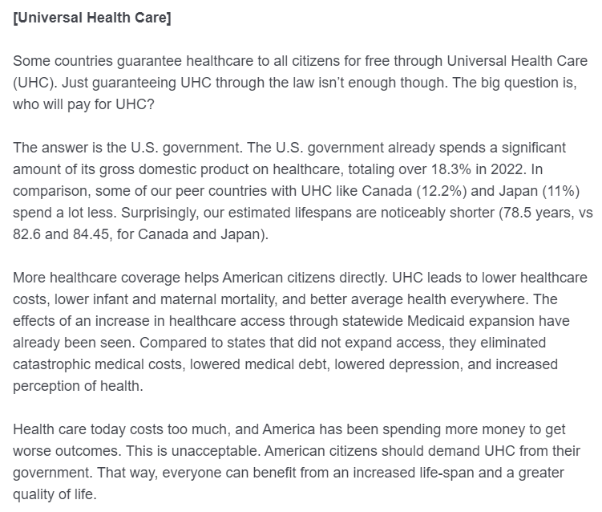
Method
Moral Responsibility Condition
Pragmatic condition

Slide 22
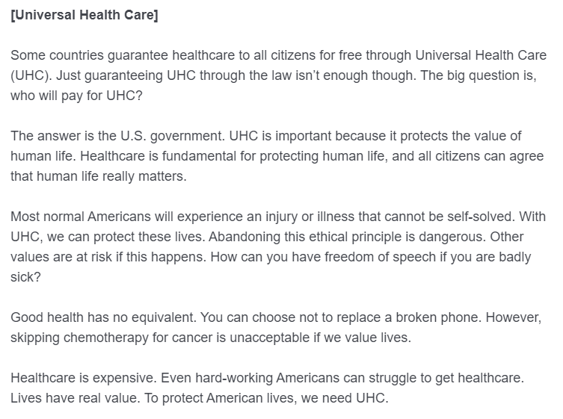
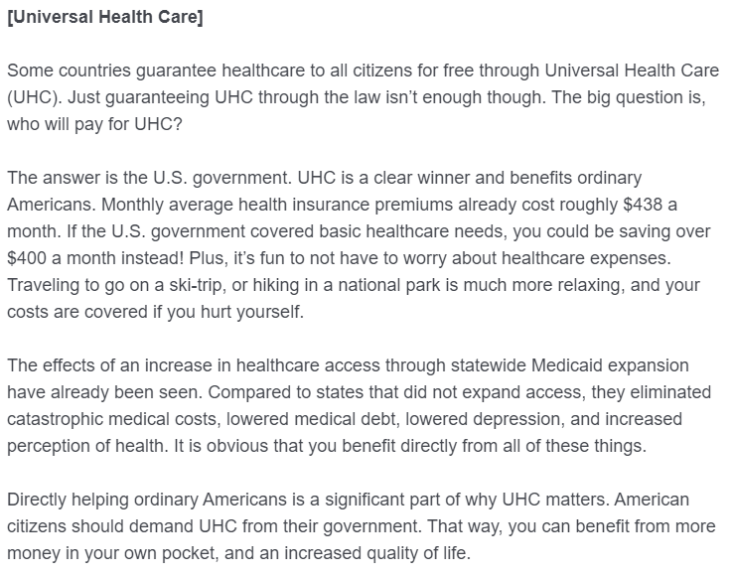
Method
Moral Piggybacking Condition
Hedonic condition

Slide 23
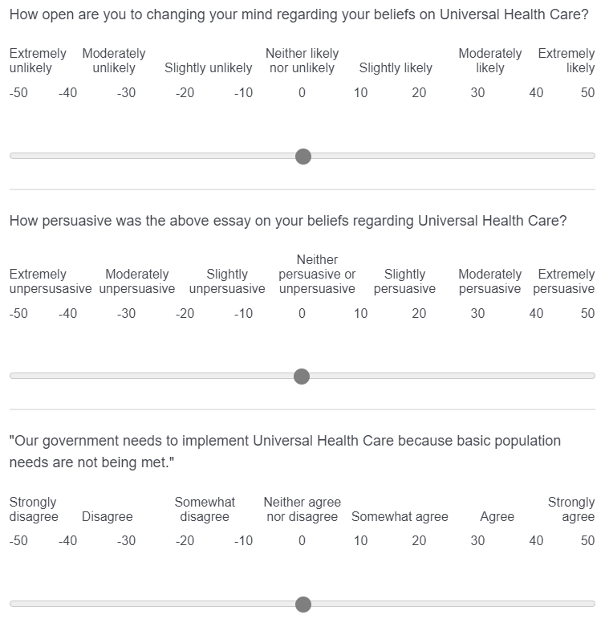
Outcomes

Slide 24
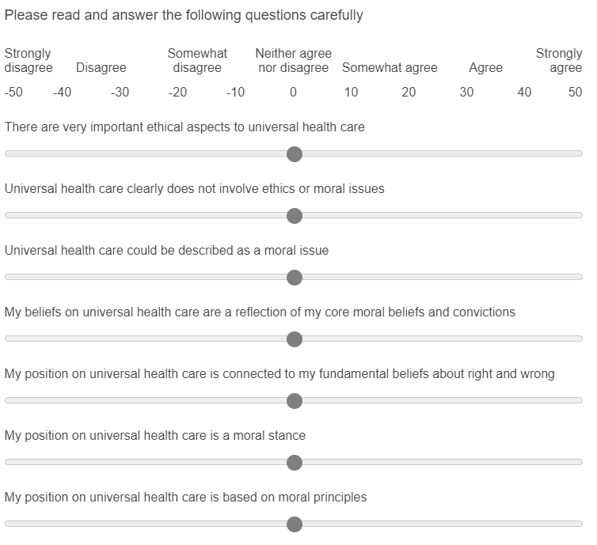
Outcomes

Slide 25
Study Design
Independent Variable – Moral Conviction:
Moral Responsibility
Moral Piggybacking
Pragmatic
Hedonic
Control
Participants were given essays with the same framing on all four topics:
Universal Health Care
Capital Punishment
Climate Change
Exercise
Main Outcomes: Support for an issue and level of moral conviction on an issue.
Additionally, measured openness to belief change for a topic, and how persuasive each essay was

Slide 26
Results

Slide 27
Results

Slide 28
Results

Slide 29
Results

Slide 30
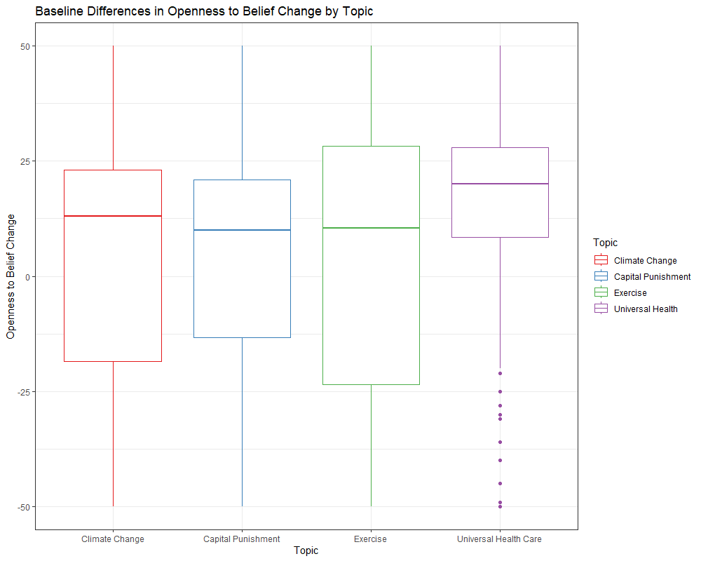
Results

Slide 31
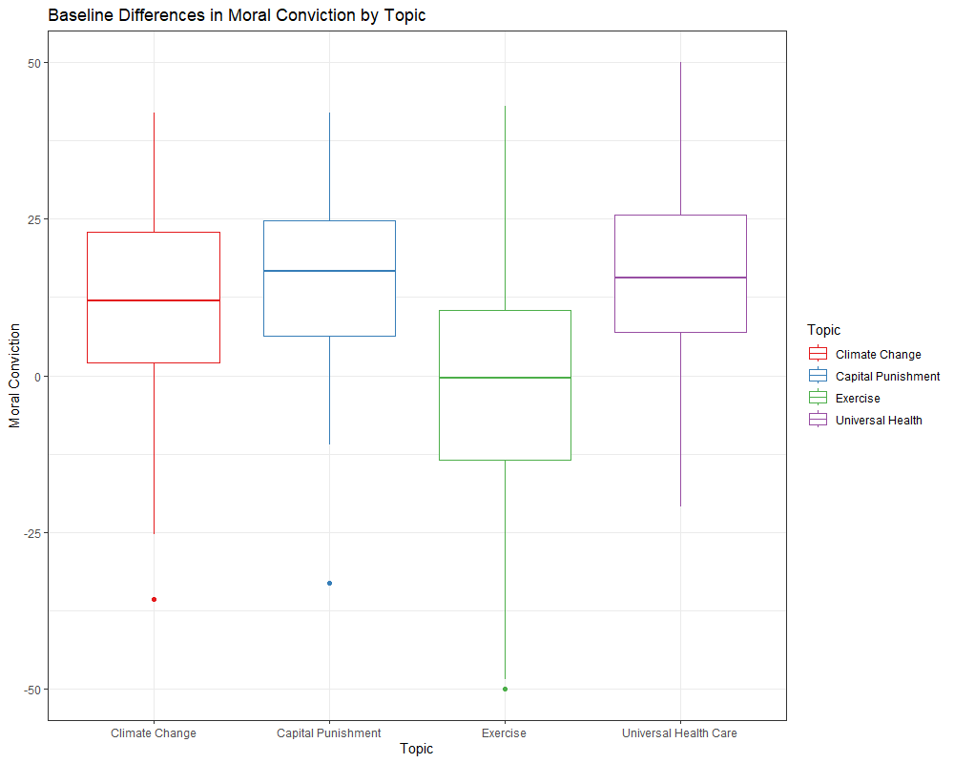
Results

Slide 32
Conclusions
Some evidence for effect of moral conviction manipulation on support for [Topic]
Pragmatic condition had significant interaction with openness to belief change for topic of UHC
No main effect found for moral conviction manipulation on level of moral conviction felt
Significantly greater baseline openness to belief change for UHC
Significantly lower baseline level of moral conviction felt for exercise

Slide 33
Proposed Study 3
Moral Conviction and Social Memory on Contemporary Issues

Slide 34
Research Questions
Can we empirically show whether social consensus is:
More effective under conditions of lower moral conviction
Less effective under conditions of greater moral conviction

Slide 35
Planned Participants
Psychology 1000 Students (N ~ 210)
Planned demographic information to collect:
Political Orientation
Age
Year in school
Preferred Gender Identification
Self Identified Race

Slide 36
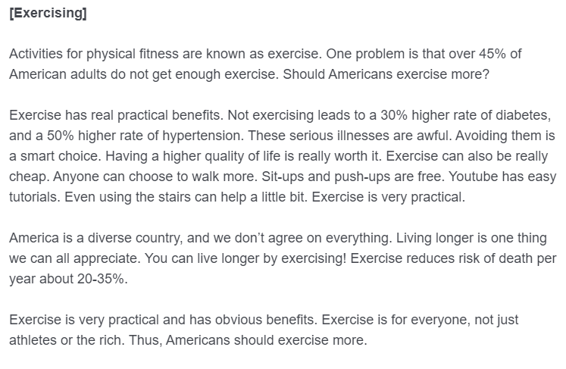
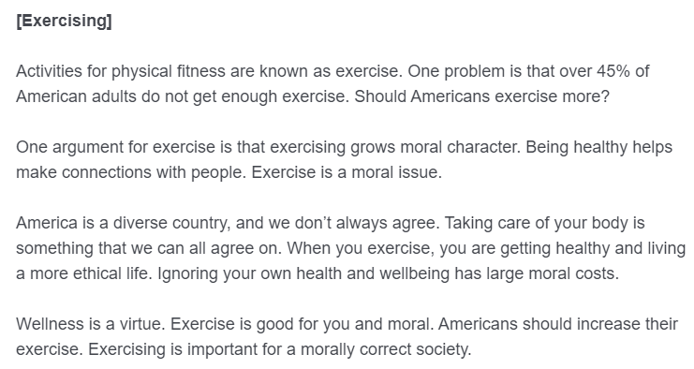
Method
Moral Responsibility condition
Pragmatic condition

Slide 37
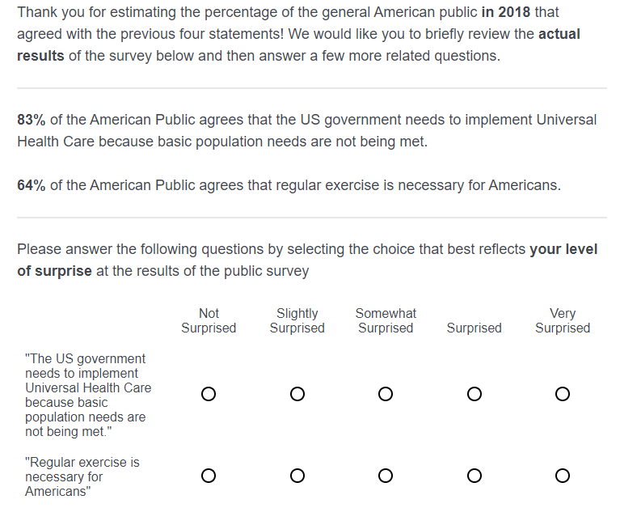
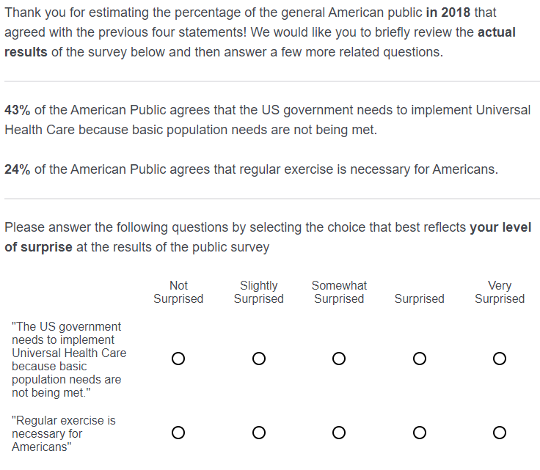
Method
Moral Responsibility condition
Pragmatic condition

Slide 38
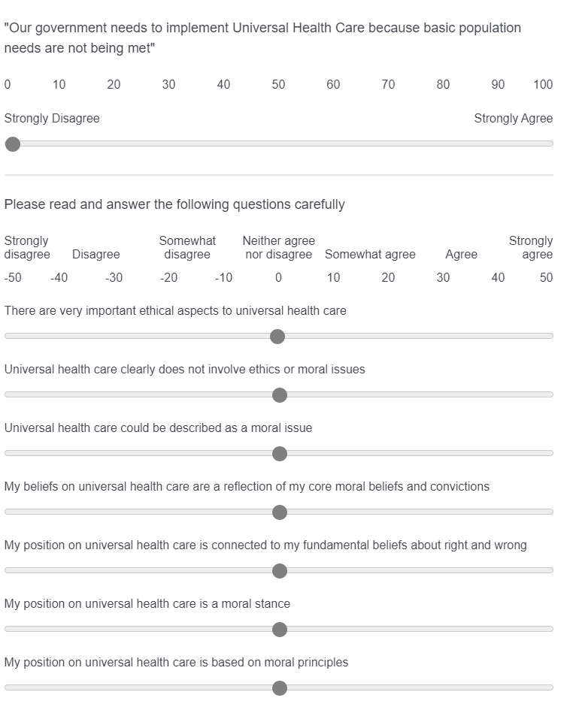
Outcomes

Slide 39
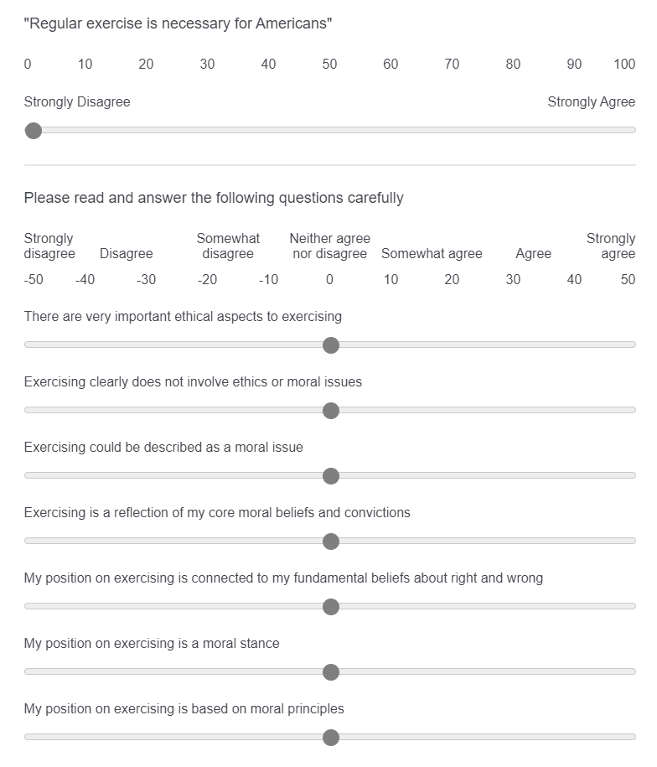
Outcomes

Slide 40
Study Design
Repeated measures design
3 Independent Variables:
Time: Before or after dual manipulations
Moral Conviction: Moral Responsibility or Pragmatic
Social Consensus: Low (-20%) or High (+20%)
2 x 2 x 2 design
Participants will measure their support and moral conviction before and after receiving both manipulations
Individual differences: Deontological and Utilitarian orientation, Numeracy, Health Literacy

Slide 41
Future Considerations
Significant changes/additions needed for introduction/literature review?
How to proceed to study 3 given some mixed evidence on our moral conviction manipulation (no main effect, but interaction with openness to belief change)
Could change to a ‘disgust’ manipulation as a mechanism to increase moral conviction (cannot be used to decrease moral conviction)
Is it a good idea to have the two topics in study 3 vary in baseline moral conviction?

